Slide 1
Reactions 8
Kinematics of Nuclear Reactions

Slide 2































Slide 3

































Slide 4






























Slide 5


























Slide 6

















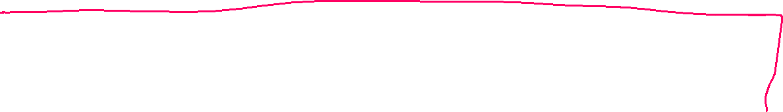

















Slide 7





















Slide 8























Slide 9




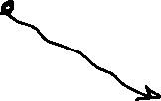






























Slide 10


























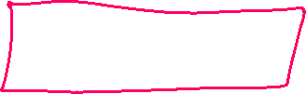



















Slide 11
































Slide 12
























Slide 13






























Slide 14















Slide 15

























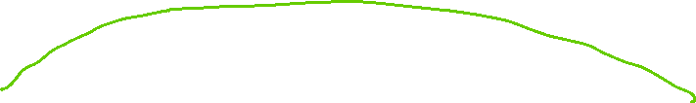





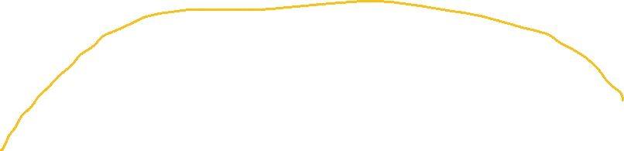

Slide 16




























